Slide 1
Lecture 3 The Business Investment Decision
Understand the key principles of business investment decisions.
Learn to evaluate investment opportunities using financial metrics.
Explore the impact of risk.

Slide 2
What is Capital Budgeting? LT 12-2
Capital Budgeting:
– represents a long-term investment decision
– involves the planning of expenditures for a project with a life of many years
– usually requires a large initial cash outflow with the expectation of future cash inflows
– uses present value analysis

Slide 3
Introduction
Concern:
Uncertainty (risk) about annual costs and inflows
Change in environment (external factors), e.g. technology, economic conditions, industry competitiveness
How to incorporate risk into the decision.

Slide 4
Executive consideration
Steps taken in the decision-making process
Search for and discover of investment opportunities
Collection of data
Engineering data
Marketing surveys
Likelihood of various event occurrence
Evaluation and decision making
Reevaluation and adjustment
See Figure 12-1

Slide 5
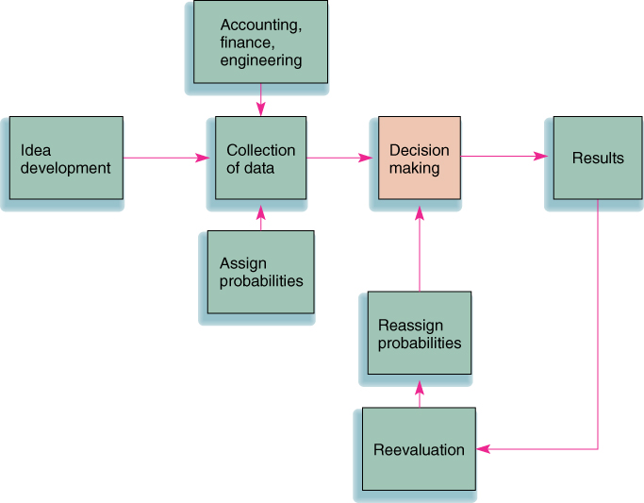
PPT 12-1
-- current status
-- Need/Source of money
-- Technical feasibility
Investment Opportunity
FIGURE 12-1
Capital budgeting procedures

Slide 6






Investment decision methods
Basic Methods for Investment Decision
Payback Period
Net Present Value (NPV)
Profitability Index (PI)
Internal Rate of Return (IRR)

Slide 7
Payback Method LT 12-4
– computes the amount of time required to recoup the initial investment
– a “cutoff period” is established
Advantages:
– easy to use (“quick and dirty” approach)
– emphasizes liquidity
In US, max. time horizon = 3-5 yrs..
A rapid payback may be important to those in industries with rapid technological change
See example

Slide 8
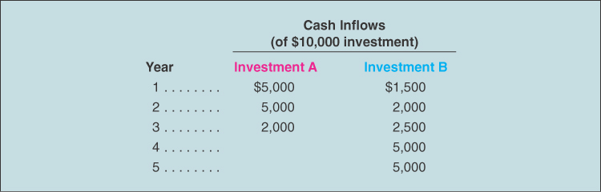
PPT 12-3
TABLE 12-3
Investment alternatives
Payback period for investment A is 2 years
Payback period for investment B is 3.8 years
Interpolate of 4000 : 5000 * (year 4-3 = 1) → 0.8 * 1
Total inflows of A = $12,000 and B = $16,000, Which one is better in terms of payback period?
Discuss disadvantage
Notes:
4-yr = 11000, 3-yr = 6000, 1 yr = 11000-6000 = 5000

Slide 9
Payback period (ii)
Disadvantages:
ignores inflows after the cutoff period and
fails to consider the time value of money
Compare the project with inflows of $1000 and $9000 and another one with inflows of $9000 and $1000?

Slide 10
Net Present Value LT 12-6
Net Present Value (NPV):
– the present value of the cash inflows minus the present value of the cash outflows
– the cash inflows are discounted back over the life of the investment
– the basic discount rate is usually the firm’s cost of capital
Average of debt and common equity (stock)

Slide 11
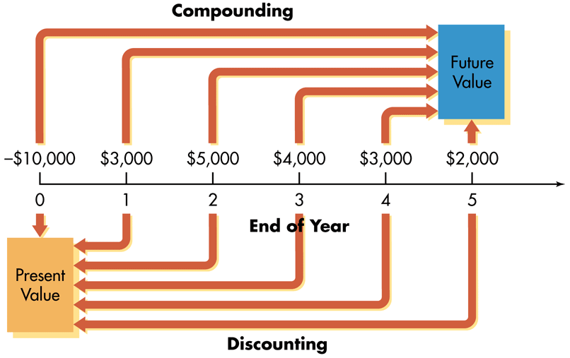
Compounding and Discounting of cashflow
Discounting
- Finding Present Value (PV)

Slide 12
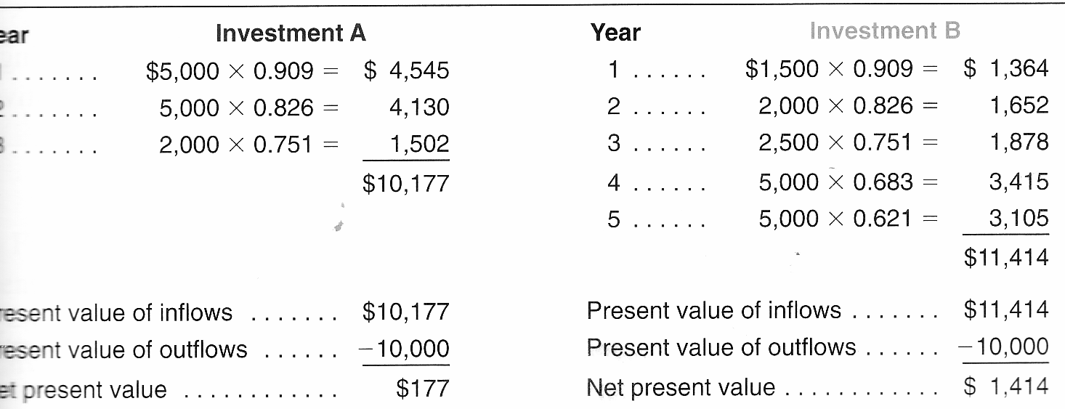
NPV 10% discount rate
By NPV, which investment is chosen, why?

Slide 13
Profitability Index (PI)
 The present value of a project’s future cash flows divided by the initial investment
PI measures how much investors get for each Dollar they invest in the project
When NPV is positive:
PI > 1
When NPV is negative:
PI < 1
Decision rule = Invest, only when PI > 1
PI is commonly referred to benefit-cost ratio
Investment A, PI = 10177/10000 = 1.017
Investment B, PI = 11414/10000 = 1.141

Slide 14
Internal Rate of Return
Internal Rate of Return (IRR):
– represents a yield or an interest rate on an investment
– requires calculating the interest rate that equates the cash outflows (cost) with the cash inflows
– Or the interest rate that makes NPV = 0
E.g. For investment A:
𝐶𝐹_{𝑡}
(1 + 𝐼𝑅𝑅)^{𝑡}
= 𝑂𝑢𝑡𝑙𝑎𝑦
5,000
1 + 𝐼𝑅𝑅 ¹
5,000
1 + 𝐼𝑅𝑅 ²
2,000
1 + 𝐼𝑅𝑅 ³
−10,000 +
+
+
= 0

Slide 15
IRR: Trial and Error for investment A
To be more accurate, the results can be interpolated
Distance of 10177 – 9874 = $303 [10% -> 12%]
Distance of 10177 – 10000 = $177
(177 / 303) * 2 = 1.17%
So, the answer is 10% + 1.17 = 11.17% IRR
For investment B, the same process give IRR = 14.33%, which investment is better, then?

Slide 16
Selection strategy
For IRR and NPV, to be acceptable, the profitability must equal or exceed the cost of capital
If investments (projects) are mutually exclusive, then only one of which will be picked.
Example
If the investment is mutually exclusive, which project will be selected?
If not mutually exclusive, which projects will be selected?
What about the investments in Table 12-3, if cost of capital is 12%
Notes:
For mutually exclusive, only Bangkok is selected. If not, then all but Singapore will be worth investment/

Slide 17
Accept/Reject Decision
Payback Method (PB):
–if PB period < cutoff period, accept the project
– if PB period > cutoff period, reject the project
Net Present Value (NPV):
– if NPV > 0, accept the project
– if NPV < 0, reject the project
Internal Rate of Return (IRR):
– if IRR > cost of capital, accept the project
– if IRR < cost of capital, reject the project

Slide 18
Ranking conflict between NPV and IRR
r | 10%
Year | 0 | 1 | 2 | 3 | 4 | NPV | PI | IRR
Project A | -100 | 50 | 50 | 50 | 50 | $53.18 | $1.53 | 34.90%
Project B | -400 | 170 | 170 | 170 | 170 | $126.25 | $1.32 | 25.21%
 Project A has a much smaller outlay than project B, although they have similar cash flow pattern
 However, size of project B is larger than size of project A
 Would you rather have a small project with higher IRR or a
large project with lower IRR?
In this case, the larger project with lower IRR has better NPV
<<<NPV shows the amount of gain, or wealth increase>>>

Slide 19
Risk-Adjusted Discount Rate
Different capital expenditure proposals with different risk levels would require different discount rates
Project with normal amount of risk discounted at the cost of capital
Project with greater than normal risk discounted at higher rate (as shown in the following slide)
Risk is assumed to be measured by the coefficient of variation (V)

Slide 20
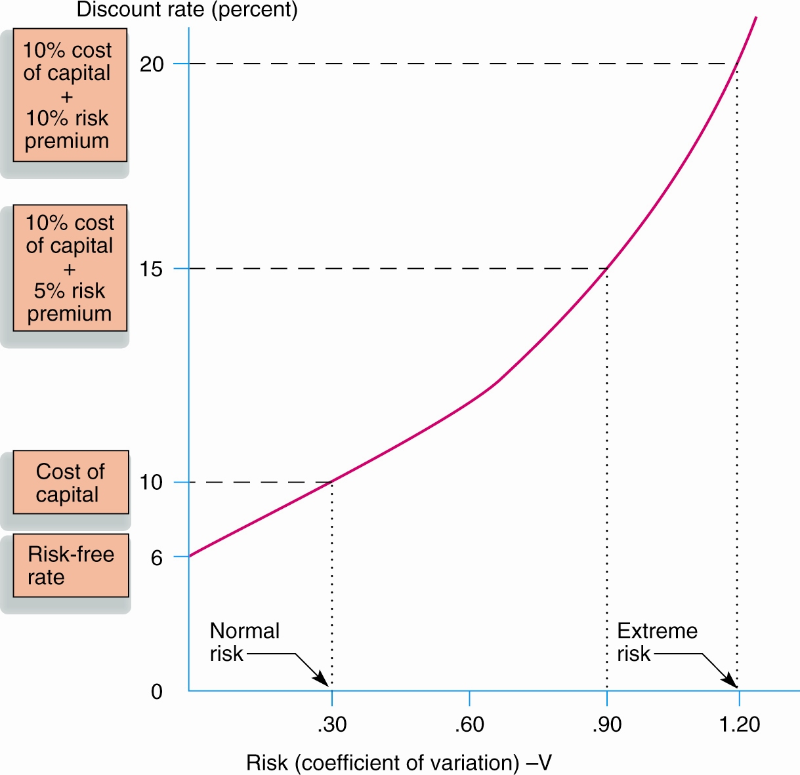
Relationship of Risk to Discount Rate
This is an example of being increasingly risk-averse at higher levels of risk and potential return

Slide 21
Increasing Risk over Time
Accurate forecasting becomes more obscure farther out in time
Unexpected events:
Create a higher standard deviation in cash flows
Increase risk associated with long-lived projects
Use of progressively higher discount rates to compensate for risk tends to penalize later cash flows more than earlier ones

Slide 22
Qualitative Measures
Setting up of risk classes based on qualitative considerations
This again equates the discount rate to the perceived risk
Example of such risk classes illustrated in the following slide

Slide 23
Risk Categories and Discount rates

Slide 24
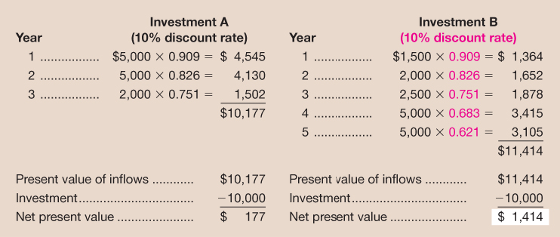
Capital Budgeting Analysis
This following table shows Investment B as a preferred investment based on NPV calculation without considering the risk factor
Table 13–4

Slide 25
Capital Budgeting Decision Adjusted for Risk: Example
Investment A calls for an addition to normal product line and is assigned discount rate of 10%
Investment B represents a new product in foreign market and must carry 20% discount rate to adjust for a large risk component

Slide 26
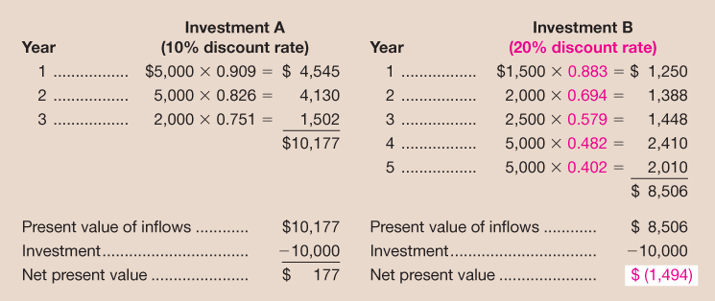
Capital Budgeting Decision Adjusted for Risk: Example (cont’d)
Investment A is the only acceptable alternative after adjusting the risk factor

Slide 27
Combining cash flow analysis and selection strategy
The rule of depreciation
calculate a depreciation schedule using the appropriate MACRS class
MACRS = Modified accelerated cost recovery system
Some referred as ADR = asset depreciation range
Asset can be written off more rapidly than the midpoint of their ADR
If midpoint of an asset’s useful life = 4 years, then it might be written off over 3 years. (Table 12-8)
The rate of depreciation (in US) is developed with the use of the half-year convention (treats as if it were put in service in midyear)
Refer to Table 12-9
Table 12-10 shows the depreciation schedule for a $50,000 asset you purchase, if it falls in 5-yr MACRS category.

Slide 28
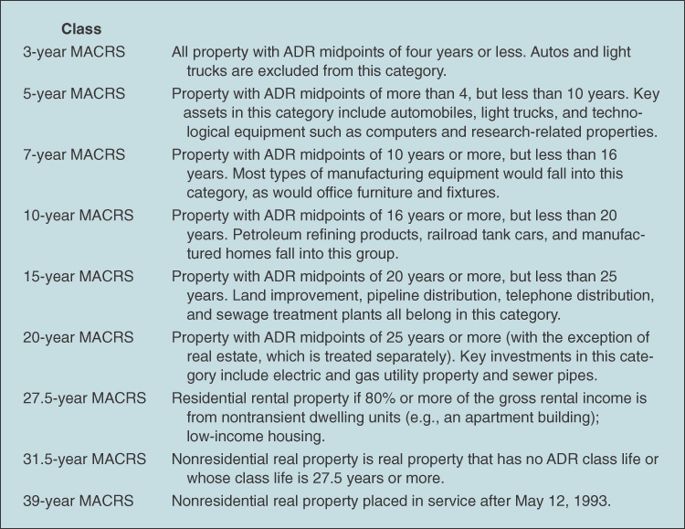
TABLE 12-8
Categories for depreciation write-off
PPT 12-8

Slide 29
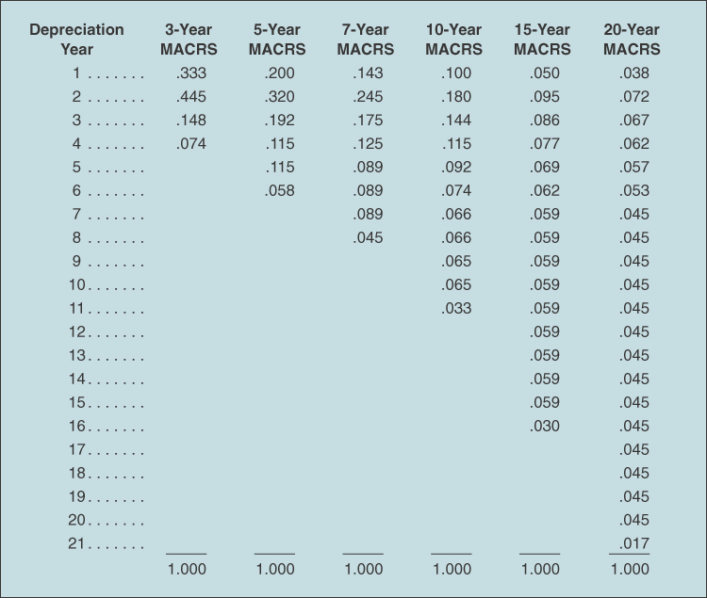
TABLE 12-9
Depreciation percentages (expressed in decimals)

Slide 30
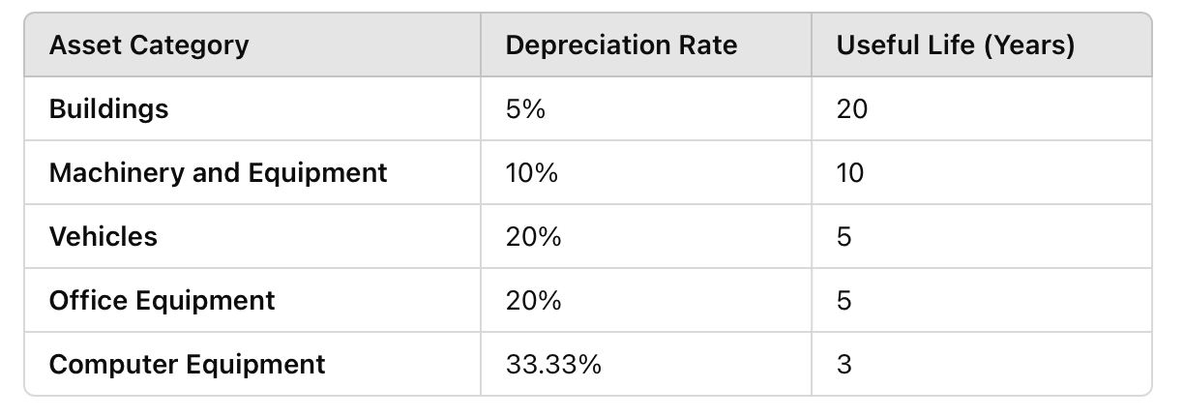
Depreciation write-off rate (Thailand)
According to GFMIS (กรมบัญชีกลาง)

Slide 31
Investment decision with more practical
To make the investment decision in a more realistic business case:
Calculate the depreciation schedule
Figure earnings, expenses and cash flow (CF)
Discount the cash flows back to the present to determine whether the machine should be purchased (only if NPV > 0)

Slide 32
Sample Case of Investment decision
Example: a $50,000 Investing decision:
Given the depreciation schedule as in Table 12-10 (5-yrs MACRS), if the project will generate income of $18,500 for the first 3 yrs, and $12,000 for the last 3 yrs, tax rate of 35%, and a cost of capital of 10%, should we invest this project?

Slide 33
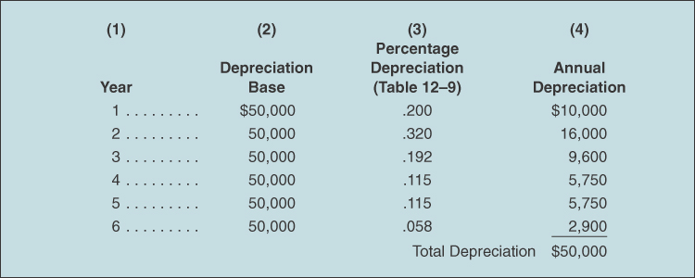
PPT 12-10
TABLE 12-10
Depreciation schedule

Slide 34
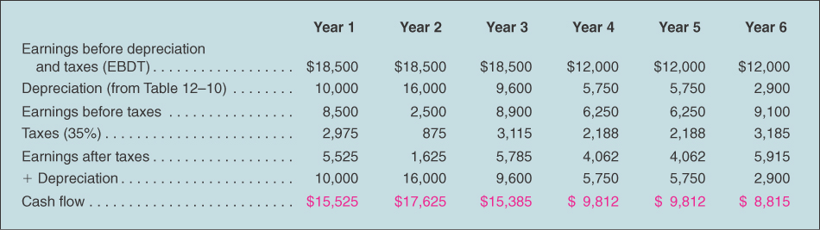
PPT 12-11
TABLE 12-11
Cash flow related to the purchase of machinery

Slide 35
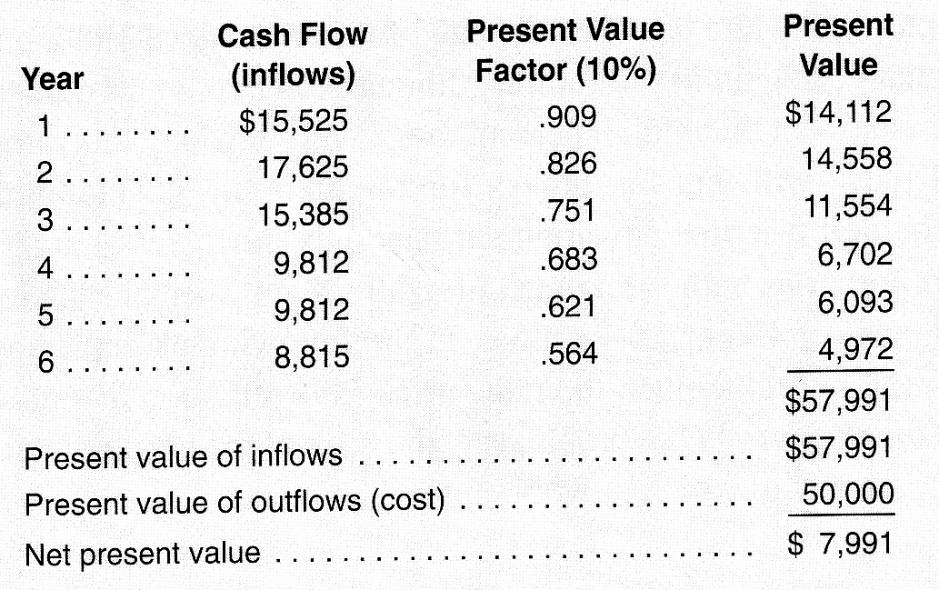
PPT 12-12
TABLE 12-12
Net present value analysis
All the cash flows in Table 12-11 are discounted back to the present with the cost of capital at 10%
Should we buy the machine?

Slide 36
Topic review
3 main methods for capital budgeting
Payback period, IRR and NPV
Each, having different criteria for deciding accept or reject the projects.
To be realistic, the consideration of capital budgeting should consider the effect of depreciation and tax policies to the net cash flow
Further effective capital budgeting can be achieved by adjusting the discount rate according to the perceived risk.

Slide 37
Further readings
Capital budgeting concepts http://www.edupristine.com/blog/capital-budgeting-techniques
Capital budgeting and risk analysis http://educ.jmu.edu/~drakepp/principles/module6/cbrisk.pdf
Cost of capital http://www.accountingtools.com/cost-of-capital

